Slide 1
Senior Care Management System
CSC 8230 Final Presentation
- Saumya Sucharita Behera

Slide 2
Table of Contents
Statistics
Project Description
Front End Features
Connection to Open EMR
ER Diagram
Future Scope

Slide 3
Interesting Statistics
By the year 2020, the number of adults age 65 and older is expected to jump to 73
million people, more than double its size in 2010. This increase means that one out of
every five Americans will be age 65 or older, which will likely drive an increase in the
demand for services from older adults and their caregivers.
Source: Making Connections-Consumer Needs in an Aging America (acl.gov)
23 percent of U.S. seniors in the survey said they did not go to a doctor when they were sick, get a recommended medical test or procedure, or fill a prescription due to high costs in the last two years. In the U.K., France, Norway and Sweden, five percent or fewer seniors reported skipping needed care due to cost concerns.
Nearly one in four (22 percent) of U.S. seniors spent $2,000 in out-of-pocket costs, such as copays, coinsurance or prescription drugs. With the exception of Switzerland, fewer than 10 percent of seniors in other countries spent this much.
Source: https://healthjournalism.org/blog/2017/11/u-s-ranks-worse-in-elder-care-vs-other-wealthy-nations/

Slide 4
Project Description
Helps seniors keep track of their major illnesses like diabetes, high blood pressure, memory issues, physical problems, etc.
Helps families in keeping track of care for their aging loved ones.
- Manage medications
- Set reminders for doctor appointments, lab work appointments
Find assisted living facilities/nursing homes near the patient

Slide 5

Front End Features
Patient can see their current illnesses, medications, caregivers.
Customized views for:
Patient view
Caregiver view
Display calender to set reminders for:
Medications
Doctor appointments
Lab work appointments
Find assisted living facilities/nursing homes near the patient using zipcode/state

Slide 6
Connection to Open EMR
Import existing patient demographics data like patient id, phone no, email id
Insurance information
ICD 10 diagnosis codes
Current medications

Slide 7
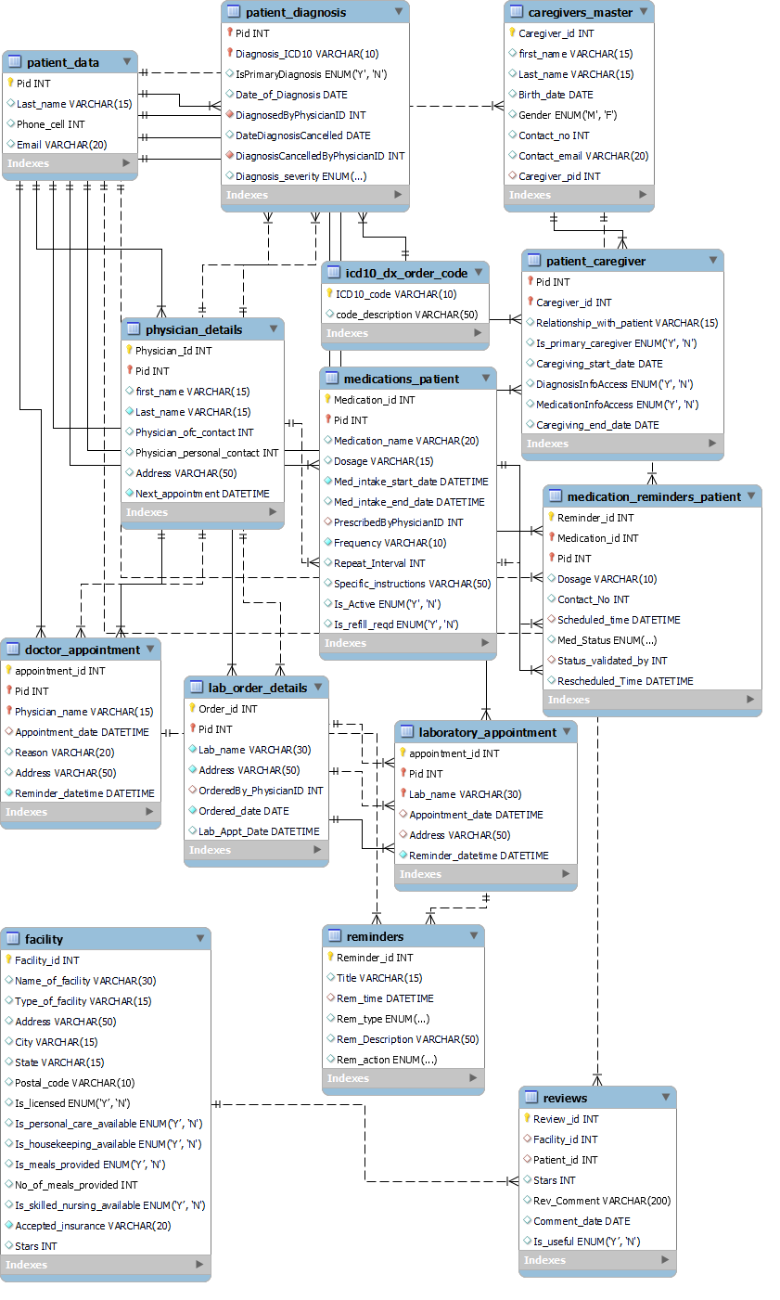
ER Diagram

Slide 8
Future Work
Import vital statistics from wearable and remote monitoring devices
Personalize the find assisted living feature catered to the patient’s needs
Send alerts to caregivers in case of emergency situations

Slide 9


Slide 10


